Slide 1
Python – Functions & I/O
ICT Learning Centre @ UL - Python and ML Foundations

Slide 2

Functions
Package Your Power

Slide 3
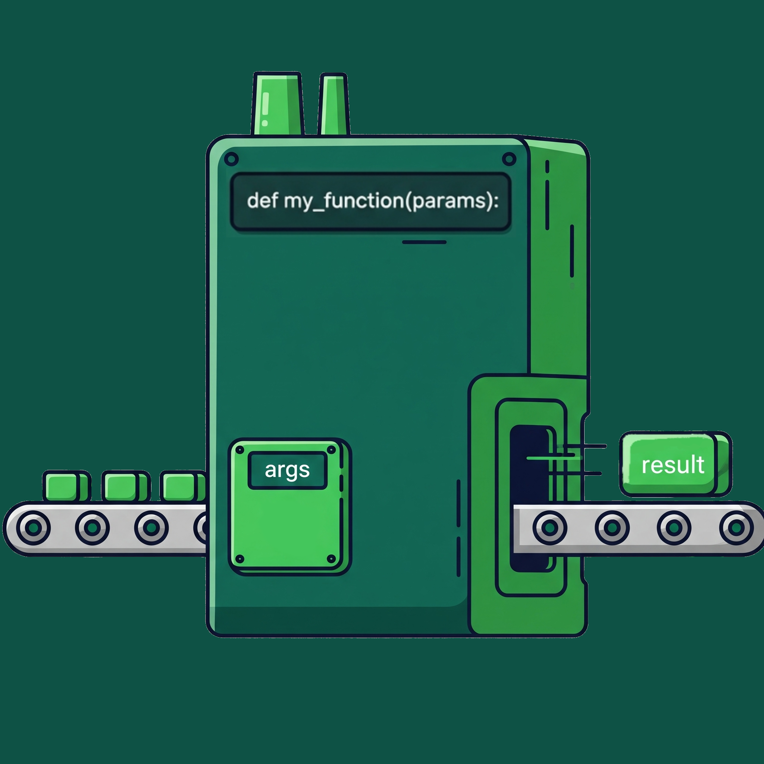
What are functions?
Block of code which only runs when it is called.
Data known as parameters can be passed into a function.
Can return data as a result (not mandatory).

Slide 4
Why use functions?
Reusability: Write code once, use it everywhere.
Organization: Break down complex problems into smaller, manageable chunks.
Readability: Give a name to a block of code, making your logic easier to follow.

Slide 5
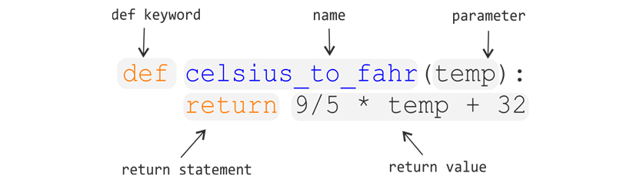
Anatomy of a function

Slide 6
Parameters vs Arguments
# Function definition
def foo(param1, param2): # parameters are placeholder variables
# Do something
# Call the function
foo(10, 20) # example arguments i.e., actual values

Slide 7
The return Statement
# Function definition
def foo(param1, param2):
return param1 + param2 # result of function returned
# Call the function
result = foo(10, 20) # result stored in variable, `result`

Slide 8
Input/Output
Interacting with users and files

Slide 9
Types of input in Python
Python Input
User Input
File Input

Slide 10
User input
Example:
user_input = input(‘Enter your name: ’)
Note:
- Default input as string.
- Other data types need to be typecast.
- Example: int(input(‘Enter your age: ‘))

Slide 11
Why Use File I/O
Program’s memory is temporary.
File I/O lets you:
Save results.
Read data from external sources (like datasets!).
Load configurations.

Slide 12
Best Practice: with Statement
Syntax
with open(‘filename.extension’, ‘mode’) as f:
text = f.read() # Use read() to read contents in file
Modern, safe way to handle files in Python.
Automatically closes files for you, even if errors occur.

Slide 13
File Modes
‘r’
Read (Default mode): Throws an error if the file doesn't exist.
‘w’
Write: Creates a new file (or overwrites an existing one).
‘a’
Append: Adds content to the end of an existing file.

Slide 14
Thank you
ICT Learning Centre,
CS1-046,
CSIS Building,
University of Limerick,
http://ictlc.ul.ie/contactus

